Slide 1

Music
Plagiarism
Gong Chen He Tianyao Liu Wenxuan

Slide 2
CONTENTS
01
02
Background
Algorithms
03
04
Experiment Results
Work Division

Slide 3

1
Background

Slide 4

Background Information
10000 new albums
of recorded music are released
100000 new musical pieces
are registered for copyright
SONY CSL, Paris
has attached the attention to the area of music plagiarism

Slide 5





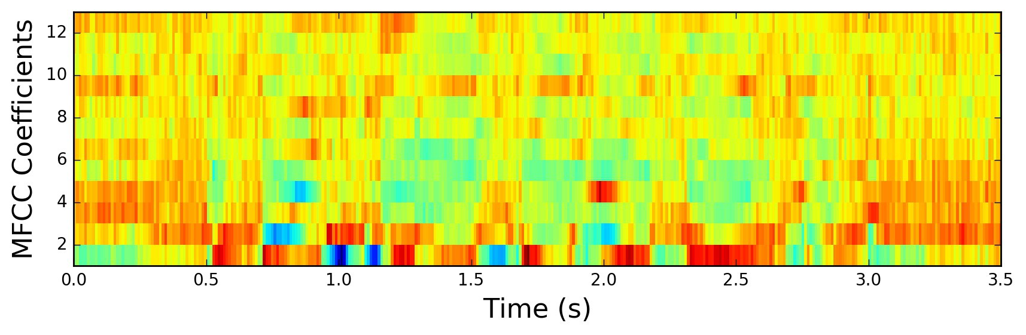
Main Problems
Based on
Low-level Features：
Failed to
Unable to
Timbre Similarity
Cepstrum Coefficients
Cope with Transposition Variant and Tempo Variant
Detect Shifting or Swapping

Slide 6
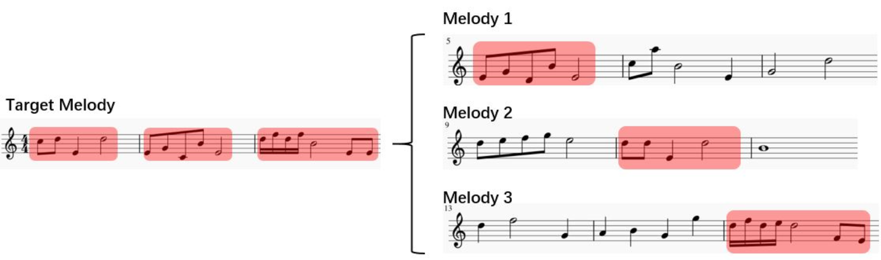
Problem Formulation
Representation of Musical Pieces as Sequences
One-to-One Similarity Comparison
One-to-Many Similarity Comparison
Formulation

Slide 7
2
Our Algorithm——
Music Plagiarism Detection
Based on
Edit-distance and Max-flow

Slide 8
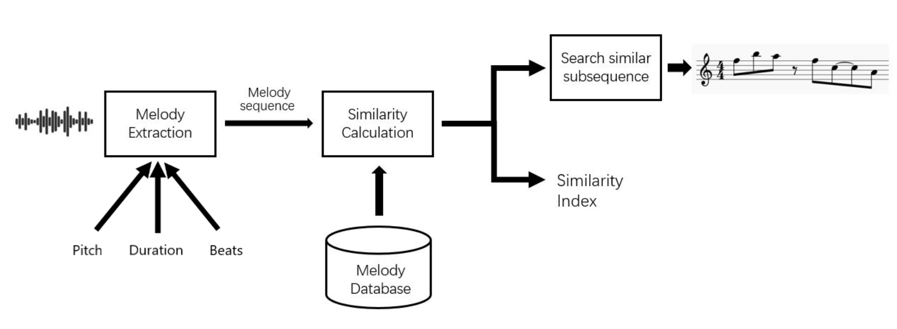
The total Algorithm

Slide 9
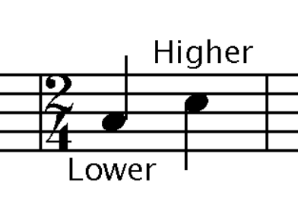

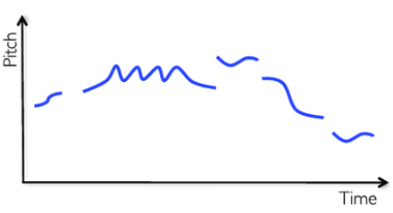
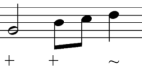
Improvements Based on Music
Transposition:
Relative pitches
Tempo:
Relative Duration
Strong or Weak:
Weighted beats
Polyphony:
Melody Extraction

Slide 10
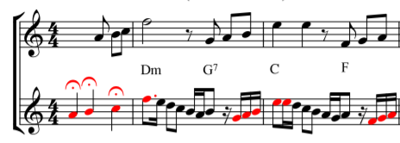
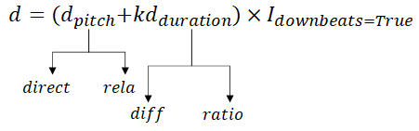
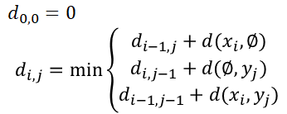
Edit distance on Symbolic notes
Advantages
Relevant
With symbolic notes:
Features: low-level to high-level

Slide 11
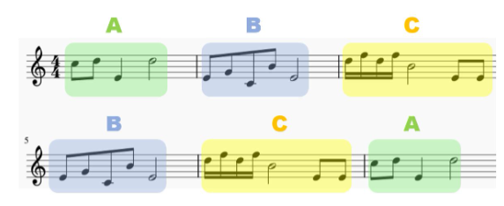
Max-flow on Symbolic notes
Advantages
Accurate and “Avoid”
Network Flow algorithm:
① Accurately find similar paragraphs
② Avoid the effect of shifting and swapping in the original song

Slide 12
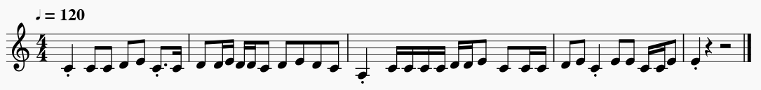
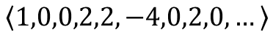
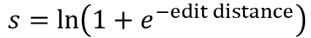
Edit distance & Max-flow Structure
Transfer to sequences

Slide 13
3
Experiment Results

Slide 14
Introduction to Experiment and Data Set
Combine
subjective experiments
with
objective experiments
Subjective:
Several case of music
plagiarism of multiple
songs judged by listeners
Objective:
17 cases of music
plagiarism of single
song judged by laws

Slide 15

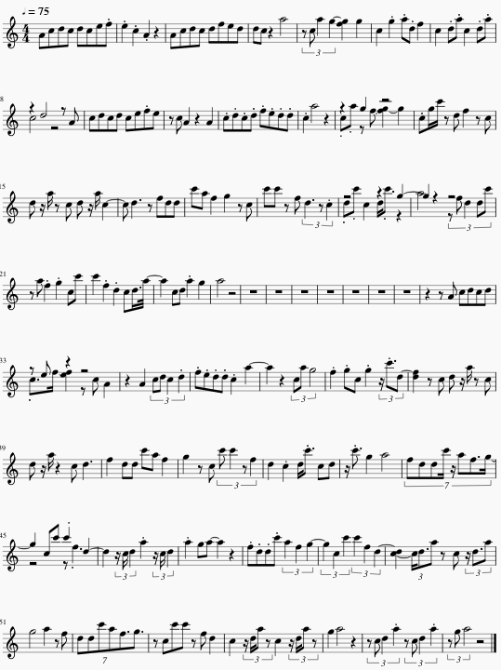
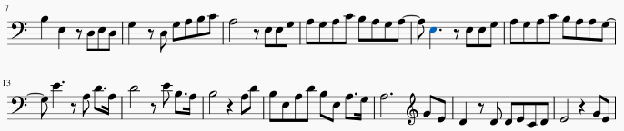
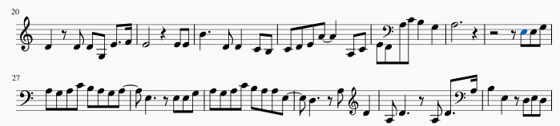
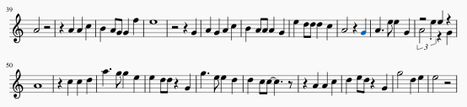
One-to-many Similar Segment Detection
离人愁
烟花易冷
s=1.0
烟花易冷
s=0.5
山外小楼夜听雨
s=0.2
* s is normalized to [0,1]

Slide 16
Experiment Result
Edit Distance | Absolute Pitch | Relative Pitch | Max Flow | Downbeat | Note Distance | Duration Ratio | Duration Difference | Average Index | Accuracy
✔ |  | ✔ |  |  |  |  |  | 6.5 | 25.00%
✔ |  | ✔ | ✔ |  |  |  |  | 2 | 56.25%
✔ |  | ✔ | ✔ | ✔ |  |  |  | 1.9365 | 62.50%
✔ |  | ✔ | ✔ |  | ✔ |  |  | 1.9375 | 68.75%
✔ |  | ✔ | ✔ |  |  | ✔ |  | 3.5625 | 37.50%
✔ |  | ✔ | ✔ |  |  |  | ✔ | 2.4375 | 43.75%
✔ |  | ✔ | ✔ | ✔ | ✔ |  |  | 1.9375 | 68.75%
✔ | ✔ |  | ✔ |  |  |  |  | 4.5 | 56.25%
✔ | ✔ |  | ✔ | ✔ |  |  |  | 4 | 56.25%
Edit Distance + Brute Force |  |  |  |  |  |  |  | 2.4375 | 43.75%
Edit Distance + Brute Force + Downbeat + Note Distance |  |  |  |  |  |  |  | 2.9375 | 56.25%

Slide 17
4
Work Division

Slide 18
Contribution of Team Member:
Tianyao He: Dataset Establishment and Process
Wenxuan Liu: Related Work Survey, Algorithm Improvenment and Presentation
Chen Gong: Experiment and Codes

Slide 19
THANK
YOU!

